Slide 1
Reversing the Server & Client
Emanuelle (Manny) Crespi

Slide 2
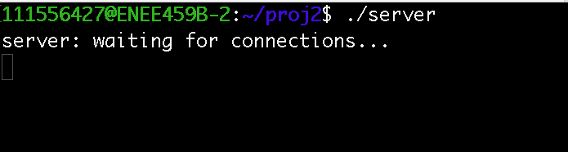
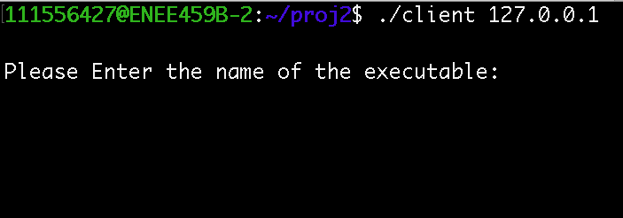
Running client & server
Notes:
Following the server-client connection, a prompt for the binary executable is displayed on the client application. These windows are to show the user-level interaction for the client.

Slide 3
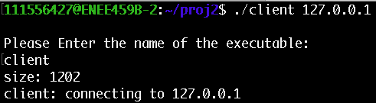
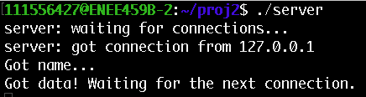
Running client & server
Notes:
Following the connection, a prompt for the binary executable is displayed on the client application. For the software to send a data packet, a valid binary must exist within the “../elfs” directory from where the binary is running. This allows the application to parse, verify and send the file. It is important to give a valid IP as a command line argument to the client binary for full functionality.

Slide 4
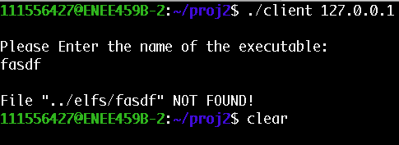
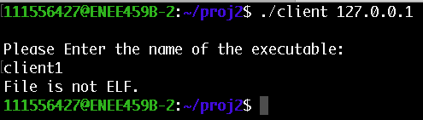
Running client & server
Notes:
The app will not send data to the server, if the binary is not present in the ‘../elfs’ directory. There are also other cases to consider where the binary is not the correct format. Attempting to use another file type that is in the correct directory will cause the program to output “File is not ELF.” before terminating

Slide 5
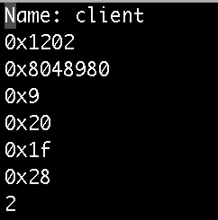
FORMAT – Head =Binary Name
- size of text section (bytes)
- entry of text section
- # of program headers
- size of program headers
- # of section headers
- size of section headers
- data form
Notes:
The format of the output files on the server side has 7 attributes of the binary. These include the size and entry point of the text section, the number of program headers and section headers, the size of the program headers and sections headers, and the form of the data in the file.

Slide 6
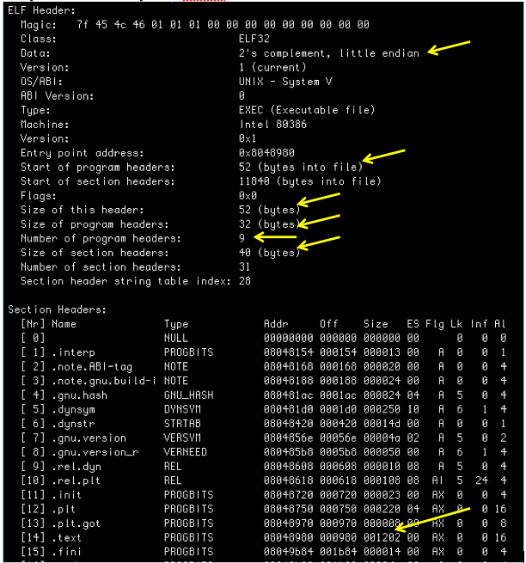
Notes:
We can verify the correctness of the data by running the readelf –h –S command on the appropriate binary.

Slide 7
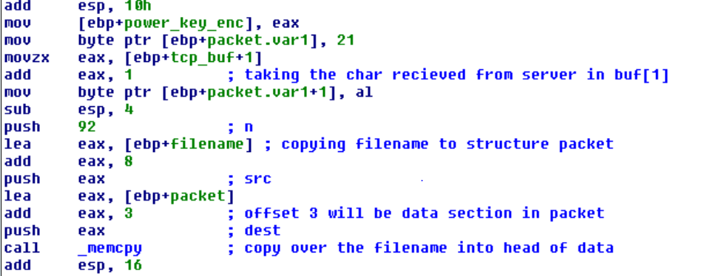
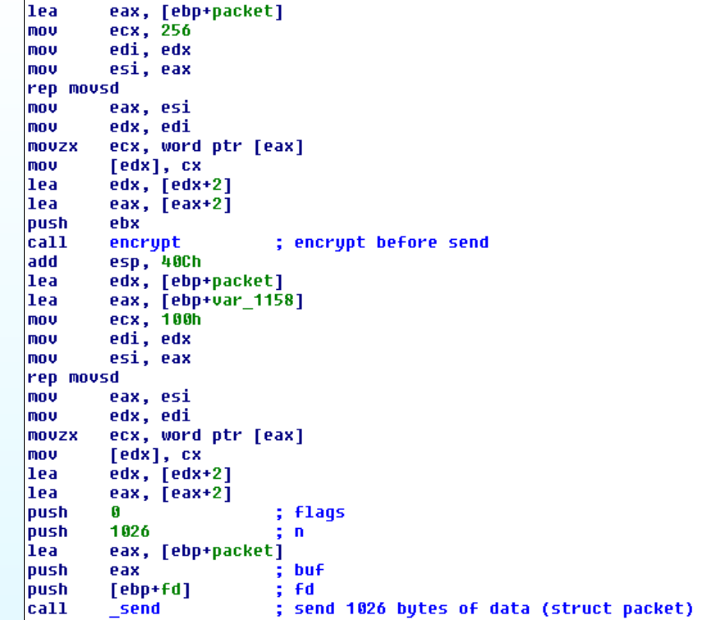
Notes:
Now that we understand the user-level interface, it’s about time we take at the implementation under the scope. It is convenient to identify the structure of the data being passed to the server. The diagram shown above, hints at the use of a data structure. The name of the structure has been changed to ‘packet’ for convenience sake.

Slide 8
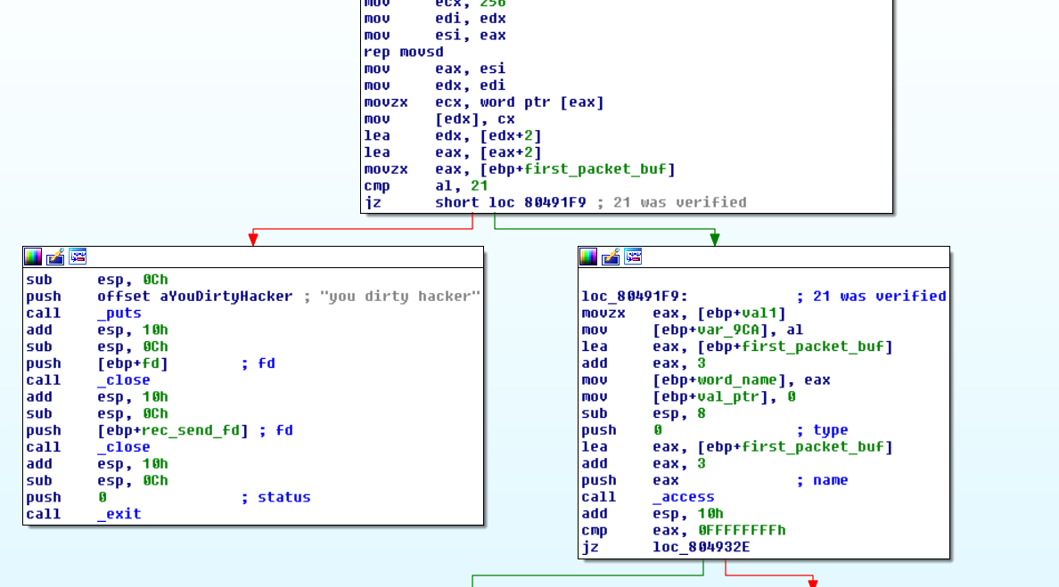
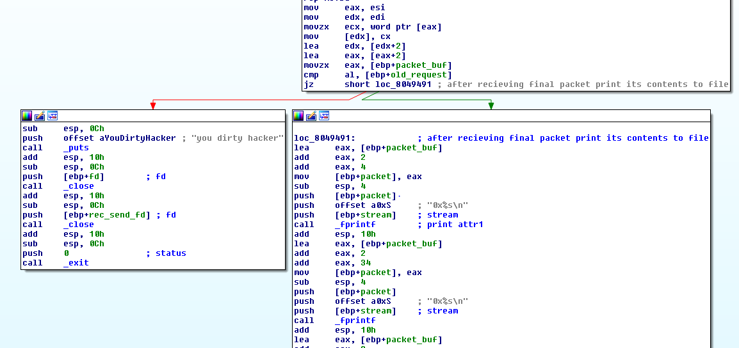
Notes:
Following the verification of the ELF file header, the client application establishes an application level handshake with the server by sending the value 17 in a buffer. The server expects this value on the other end, and responds by sending 18 before moving on to the next phase. On the client side, the next two sends will complete the transaction. The first send will contain a request value appended to the name of the ELF file, and the last send will forward the entire packet.

Slide 9
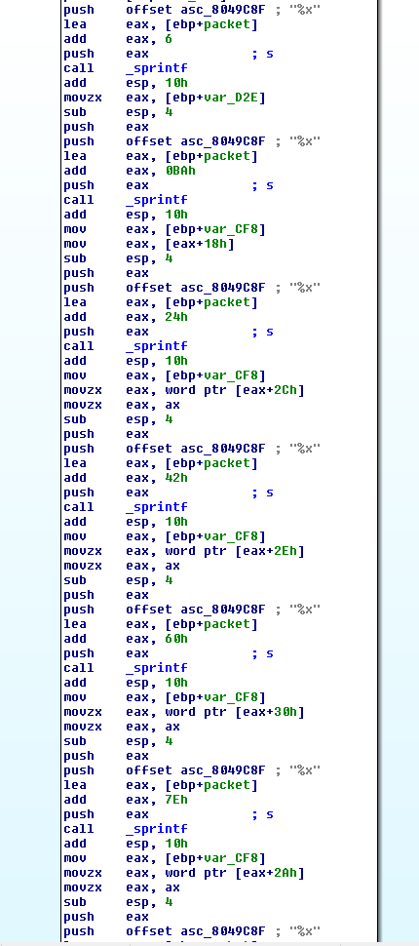
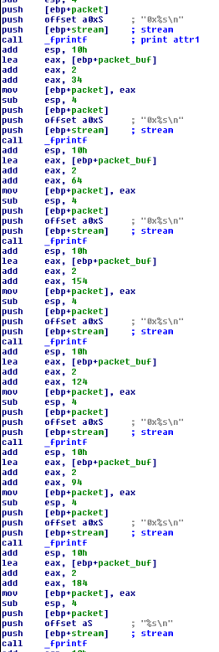
Notes:
Immediately after these two requests are fulfilled, the server proceeds to write the parsed attributes to the file. The offsets by which the server extracts from the structure indicate a mapping for the data elements that are written to the file since they are the same offsets as the ones used by the client to populate the buffer before sending the packet. The figures here show this overlap.

Slide 10
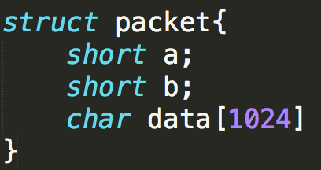
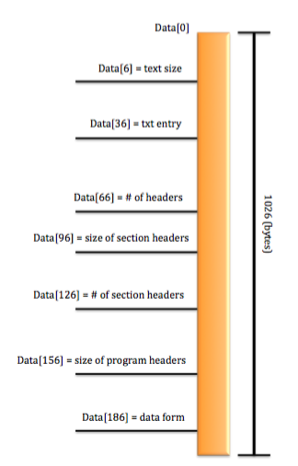
Data Packets
Notes:
The layout of the data packets can be determined by the hints given in the assembly. The client writes to these offsets in the data vector before obfuscating and sending it over to the server. The server reads these attributes at the same offset, thus verifying the location and intended identity of a recovered packet.

Slide 11
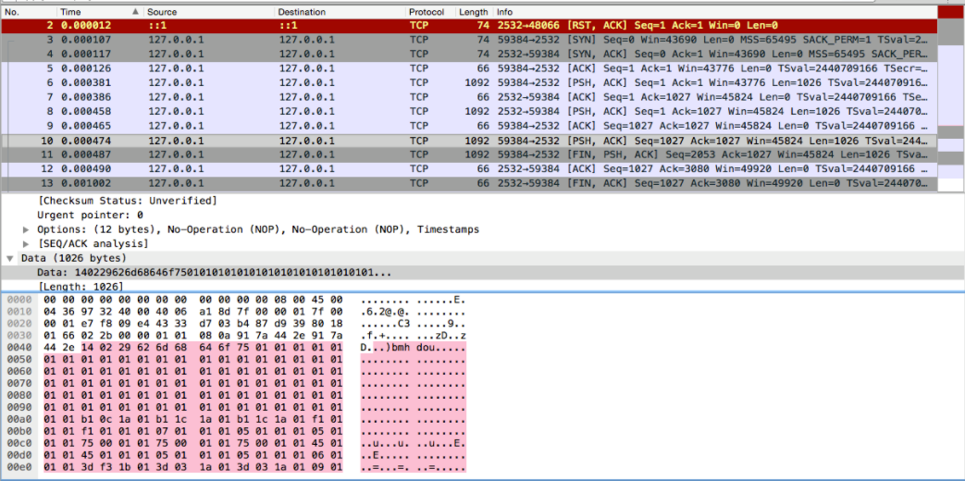
Data packet on Wireshark
Notes:
At this point we know the order of the packets being sent and by whom. Using wire-shark to read intercepted messages, it has become clear that the message 09e44333 shows up in multiple packets during the sending process. Even though the encryption/decryption scheme is overly complicated to reverse, we can still analyze a consistent pattern between packets being sent to the server.

Slide 12
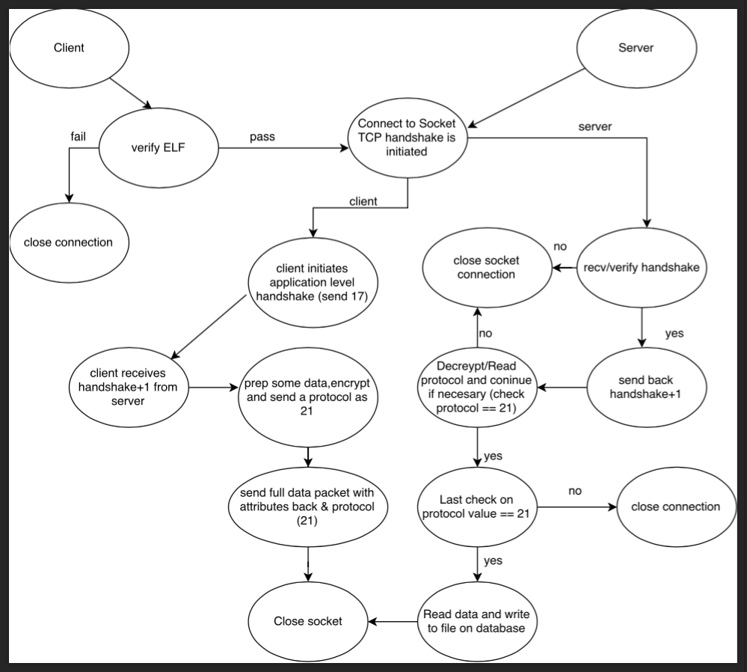
Flow chart analysis
Notes:
With all of the information at hand, we can put together a logical flow chart to better understand the client-server relationship. This is useful for future work on this project so others can pick up where this left off.

Slide 13
Vulnerabilities/Limitations
- No checksum
- The handshake/verification is a static process
- Messages can be intercepted and corrupted
- The encryption is ridiculous!
Notes:
It is also important to note that there is no checksum used on the other end to detect malformed data. If a packet, sent from client to server, has been intercepted and modified, the server would never be aware of this. It would continue to load the data into its database as long as there is a correct header = 21.

